Slide 1
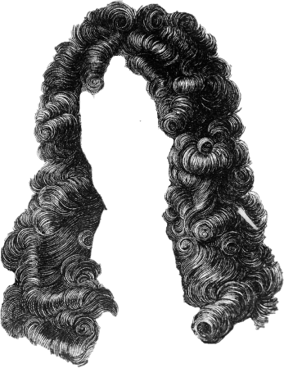


Slide 13

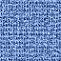
easy
EASY

Slide 14
easy
EASY

Slide 15
easy
EASY

Slide 16
easy
EASY

Slide 17
easy
EASY

Slide 18
easy
EASY

Slide 19
easy
EASY

Slide 20
easy
EASY

Slide 21
easy
EASY

Slide 22
easy
EASY

Slide 23
easy
EASY

Slide 24
easy
EASY

Slide 25
easy
EASY

Slide 26
easy
EASY

Slide 27
easy
EASY

Slide 28
easy
EASY

Slide 29
easy
EASY

Slide 30
easy
EASY

Slide 31
easy
EASY

Slide 32
easy
EASY

Slide 33
easy
EASY

Slide 34
easy
EASY

Slide 35
As
easy
EASY

Slide 36
Assum

Slide 37
Assumpt

Slide 38
Assumpti

Slide 39
Assumptions:

Slide 40
Assumptions:

Slide 41
Assumptions:

Slide 42
Assumptions:

Slide 43
Assumptions:

Slide 44
Assumptions:

Slide 45
Assumptions:

Slide 46
Assumptions:

Slide 47
Assumptions:

Slide 48
Assumptions:

Slide 49
Assumptions:

Slide 50
Assumptions:

Slide 51
Assumptions:
1)

Slide 52
Assumptions:
1) The

Slide 53
Assumptions:
1) The wav

Slide 54
Assumptions:
1) The wave

Slide 55
Assumptions:
1) The wave fun

Slide 56
Assumptions:
1) The wave functi

Slide 57
Assumptions:
1) The wave function

Slide 58
Assumptions:
1) The wave function ob

Slide 59
Assumptions:
1) The wave function obeys

Slide 60
Assumptions:
1) The wave function obeys the

Slide 61
Assumptions:
1) The wave function obeys the wav

Slide 62
Assumptions:
1) The wave function obeys the wave eq

Slide 63
Assumptions:
1) The wave function obeys the wave equat

Slide 64
Assumptions:
1) The wave function obeys the wave equation

Slide 65
Assumptions:
1) The wave function obeys the wave equation

Slide 66
Assumptions:
1) The wave function obeys the wave equation

Slide 67
Assumptions:
1) The wave function obeys the wave equation

Slide 68
Assumptions:
1) The wave function obeys the wave equation

Slide 69
Assumptions:
1) The wave function obeys the wave equation

Slide 70
Assumptions:
1) The wave function obeys the wave equation

Slide 71
Assumptions:
1) The wave function obeys the wave equation

Slide 72
Assumptions:
1) The wave function obeys the wave equation

Slide 73
Assumptions:
1) The wave function obeys the wave equation

Slide 74
Assumptions:
1) The wave function obeys the wave equation

Slide 75
Assumptions:
1) The wave function obeys the wave equation

Slide 76
Assumptions:
1) The wave function obeys the wave equation

Slide 77
Assumptions:
1) The wave function obeys the wave equation

Slide 78
Assumptions:
1) The wave function obeys the wave equation

Slide 79
Assumptions:
1) The wave function obeys the wave equation

Slide 80

Assumptions:
1) The wave function obeys the wave equation

Slide 81
Assumptions:
1) The wave function obeys the wave equation

Slide 82
Assumptions:
1) The wave function obeys the wave equation

Slide 83
Assumptions:
1) The wave function obeys the wave equation

Slide 84
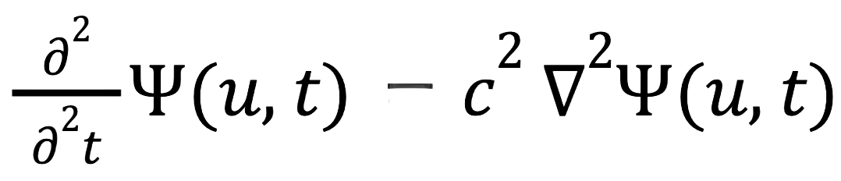
Assumptions:
1) The wave function obeys the wave equation

Slide 85
Assumptions:
1) The wave function obeys the wave equation

Slide 86
Assumptions:
1) The wave function obeys the wave equation

Slide 87
Assumptions:
1) The wave function obeys the wave equation

Slide 88
Assumptions:
1) The wave function obeys the wave equation

Slide 89
Assumptions:
1) The wave function obeys the wave equation

Slide 90
Assumptions:
1) The wave function obeys the wave equation

Slide 91
Assumptions:
1) The wave function obeys the wave equation

Slide 92
Assumptions:
1) The wave function obeys the wave equation
2)

Slide 93
Assumptions:
1) The wave function obeys the wave equation
2) one

Slide 94
Assumptions:
1) The wave function obeys the wave equation
2) one inf

Slide 95
Assumptions:
1) The wave function obeys the wave equation
2) one inf

Slide 96
Assumptions:
1) The wave function obeys the wave equation
2) one infini

Slide 97
Assumptions:
1) The wave function obeys the wave equation
2) one infinitesi

Slide 98
Assumptions:
1) The wave function obeys the wave equation
2) one infinitesimal

Slide 99
Assumptions:
1) The wave function obeys the wave equation
2) one infinitesimally

Slide 100
Assumptions:
1) The wave function obeys the wave equation
2) one infinitesimally sm

Slide 101
Assumptions:
1) The wave function obeys the wave equation
2) one infinitesimally small

Slide 102
Assumptions:
1) The wave function obeys the wave equation
2) one infinitesimally small pie

Slide 103
Assumptions:
1) The wave function obeys the wave equation
2) one infinitesimally small piece

Slide 104
Assumptions:
1) The wave function obeys the wave equation
2) one infinitesimally small piece of

Slide 105
Assumptions:
1) The wave function obeys the wave equation
2) one infinitesimally small piece of the

Slide 106
Assumptions:
1) The wave function obeys the wave equation
2) one infinitesimally small piece of the rod

Slide 107
Assumptions:
1) The wave function obeys the wave equation
2) one infinitesimally small piece of the rod
acc

Slide 108
Assumptions:
1) The wave function obeys the wave equation
2) one infinitesimally small piece of the rod
accele

Slide 109
Assumptions:
1) The wave function obeys the wave equation
2) one infinitesimally small piece of the rod
accelera

Slide 110
Assumptions:
1) The wave function obeys the wave equation
2) one infinitesimally small piece of the rod accelerates

Slide 111
Assumptions:
1) The wave function obeys the wave equation
2) one infinitesimally small piece of the rod accelerates at

Slide 112
Assumptions:
1) The wave function obeys the wave equation
2) one infinitesimally small piece of the rod accelerates at the

Slide 113
Assumptions:
1) The wave function obeys the wave equation
2) one infinitesimally small piece of the rod accelerates at the sam

Slide 114
Assumptions:
1) The wave function obeys the wave equation
2) one infinitesimally small piece of the rod accelerates at the same ra

Slide 115
Assumptions:
1) The wave function obeys the wave equation
2) one infinitesimally small piece of the rod accelerates at the same rate

Slide 116
Assumptions:
1) The wave function obeys the wave equation
2) one infinitesimally small piece of the rod accelerates at the same rate as

Slide 117
Assumptions:
1) The wave function obeys the wave equation
2) one infinitesimally small piece of the rod accelerates at the same rate as the

Slide 118
Assumptions:
1) The wave function obeys the wave equation
2) one infinitesimally small piece of the rod accelerates at the same rate as the pie

Slide 119
Assumptions:
1) The wave function obeys the wave equation
2) one infinitesimally small piece of the rod accelerates at the same rate as the piece

Slide 120
Assumptions:
1) The wave function obeys the wave equation
2) one infinitesimally small piece of the rod accelerates at the same rate as the piece of

Slide 121
Assumptions:
1) The wave function obeys the wave equation
2) one infinitesimally small piece of the rod accelerates at the same rate as the piece of rod

Slide 122
Assumptions:
1) The wave function obeys the wave equation
2) one infinitesimally small piece of the rod accelerates at the same rate as the piece of rod next

Slide 123
Assumptions:
1) The wave function obeys the wave equation
2) one infinitesimally small piece of the rod accelerates at the same rate as the piece of rod next to it.

Slide 124
Assumptions:
1) The wave function obeys the wave equation
2) one infinitesimally small piece of the rod accelerates at the same rate as the piece of rod next to it.

Slide 125
Assumptions:
1) The wave function obeys the wave equation
2) one infinitesimally small piece of the rod accelerates at the same rate as the piece of rod next to it.

Slide 126
Assumptions:
1) The wave function obeys the wave equation
2) one infinitesimally small piece of the rod accelerates at the same rate as the piece of rod next to it.

Slide 127
Assumptions:
1) The wave function obeys the wave equation
2) one infinitesimally small piece of the rod accelerates at the same rate as the piece of rod next to it.

Slide 128
Assumptions:
1) The wave function obeys the wave equation
2) one infinitesimally small piece of the rod accelerates at the same rate as the piece of rod next to it.

Slide 129
Assumptions:
1) The wave function obeys the wave equation
2) one infinitesimally small piece of the rod accelerates at the same rate as the piece of rod next to it.

Slide 130
Assumptions:
1) The wave function obeys the wave equation
2) one infinitesimally small piece of the rod accelerates at the same rate as the piece of rod next to it.

Slide 131
Assumptions:
1) The wave function obeys the wave equation
2) one infinitesimally small piece of the rod accelerates at the same rate as the piece of rod next to it.

Slide 132
Assumptions:
1) The wave function obeys the wave equation
2) one infinitesimally small piece of the rod accelerates at the same rate as the piece of rod next to it.

Slide 133
Assumptions:
1) The wave function obeys the wave equation
2) one infinitesimally small piece of the rod accelerates at the same rate as the piece of rod next to it.

Slide 134
Assumptions:
1) The wave function obeys the wave equation
2) one infinitesimally small piece of the rod accelerates at the same rate as the piece of rod next to it.

Slide 135
Assumptions:
1) The wave function obeys the wave equation
2) one infinitesimally small piece of the rod accelerates at the same rate as the piece of rod next to it.

Slide 136
Assumptions:
1) The wave function obeys the wave equation
2) one infinitesimally small piece of the rod accelerates at the same rate as the piece of rod next to it.

Slide 137
Assumptions:
1) The wave function obeys the wave equation
2) one infinitesimally small piece of the rod accelerates at the same rate as the piece of rod next to it.

Slide 138
Assumptions:
1) The wave function obeys the wave equation
2) one infinitesimally small piece of the rod accelerates at the same rate as the piece of rod next to it.

Slide 139
Assumptions:
1) The wave function obeys the wave equation
2) one infinitesimally small piece of the rod accelerates at the same rate as the piece of rod next to it.

Slide 140
Assumptions:
1) The wave function obeys the wave equation
2) one infinitesimally small piece of the rod accelerates at the same rate as the piece of rod next to it.

Slide 141
Assumptions:
1) The wave function obeys the wave equation
2) one infinitesimally small piece of the rod accelerates at the same rate as the piece of rod next to it.

Slide 142
Assumptions:
1) The wave function obeys the wave equation
2) one infinitesimally small piece of the rod accelerates at the same rate as the piece of rod next to it.

Slide 143
Assumptions:
1) The wave function obeys the wave equation
2) one infinitesimally small piece of the rod accelerates at the same rate as the piece of rod next to it.

Slide 144
Assumptions:
1) The wave function obeys the wave equation
2) one infinitesimally small piece of the rod accelerates at the same rate as the piece of rod next to it.

Slide 145
Assumptions:
1) The wave function obeys the wave equation
2) one infinitesimally small piece of the rod accelerates at the same rate as the piece of rod next to it.

Slide 146
Assumptions:
1) The wave function obeys the wave equation
2) one infinitesimally small piece of the rod accelerates at the same rate as the piece of rod next to it.

Slide 147
Assumptions:
1) The wave function obeys the wave equation
2) one infinitesimally small piece of the rod accelerates at the same rate as the piece of rod next to it.

Slide 148
Assumptions:
1) The wave function obeys the wave equation
2) one infinitesimally small piece of the rod accelerates at the same rate as the piece of rod next to it.

Slide 149
Assumptions:
1) The wave function obeys the wave equation
2) one infinitesimally small piece of the rod accelerates at the same rate as the piece of rod next to it,

Slide 150
Assumptions:
1) The wave function obeys the wave equation
2) one infinitesimally small piece of the rod accelerates at the same rate as the piece of rod next to it.

Slide 151
Assumptions:
1) The wave function obeys the wave equation
2) one infinitesimally small piece of the rod accelerates at the same rate as the piece of rod next to it.

Slide 152
Assumptions:
1) The wave function obeys the wave equation
2) one infinitesimally small piece of the rod accelerates at the same rate as the piece of rod next to it.

Slide 153
Assumptions:
1) The wave function obeys the wave equation
2) one infinitesimally small piece of the rod accelerates at the same rate as the piece of rod next to it.

Slide 154
Assumptions:
1) The wave function obeys the wave equation
2) one infinitesimally small piece of the rod accelerates at the same rate as the piece of rod next to it.

Slide 155
Assumptions:
1) The wave function obeys the wave equation
2) one infinitesimally small piece of the rod accelerates at the same rate as the piece of rod next to it.

Slide 156
Assumptions:
1) The wave function obeys the wave equation
2) one infinitesimally small piece of the rod accelerates at the same rate as the piece of rod next to it.

Slide 157
Assumptions:
1) The wave function obeys the wave equation
2) one infinitesimally small piece of the rod accelerates at the same rate as the piece of rod next to it.

Slide 158
Assumptions:
1) The wave function obeys the wave equation
2) one infinitesimally small piece of the rod accelerates at the same rate as the piece of rod next to it.

Slide 159
Assumptions:
1) The wave function obeys the wave equation
2) one infinitesimally small piece of the rod accelerates at the same rate as the piece of rod next to it.

Slide 160
Assumptions:
1) The wave function obeys the wave equation
2) one infinitesimally small piece of the rod accelerates at the same rate as the piece of rod next to it.

Slide 161
Assumptions:
1) The wave function obeys the wave equation
2) one infinitesimally small piece of the rod accelerates at the same rate as the piece of rod next to it.

Slide 162
Assumptions:
1) The wave function obeys the wave equation
2) one infinitesimally small piece of the rod accelerates at the same rate as the piece of rod next to it.

Slide 163
Assumptions:
1) The wave function obeys the wave equation
2) one infinitesimally small piece of the rod accelerates at the same rate as the piece of rod next to it.

Slide 164
Assumptions:
1) The wave function obeys the wave equation
2) one infinitesimally small piece of the rod accelerates at the same rate as the piece of rod next to it.

Slide 165
Assumptions:
1) The wave function obeys the wave equation
2) one infinitesimally small piece of the rod accelerates at the same rate as the piece of rod next to it.

Slide 166
Assumptions:
1) The wave function obeys the wave equation
2) one infinitesimally small piece of the rod accelerates at the same rate as the piece of rod next to it.

Slide 167
Assumptions:
1) The wave function obeys the wave equation
2) one infinitesimally small piece of the rod accelerates at the same rate as the piece of rod next to it.

Slide 168
Assumptions:
1) The wave function obeys the wave equation
2) one infinitesimally small piece of the rod accelerates at the same rate as the piece of rod next to it.

Slide 169
Assumptions:
1) The wave function obeys the wave equation
2) one infinitesimally small piece of the rod accelerates at the same rate as the piece of rod next to it.

Slide 170
Assumptions:
1) The wave function obeys the wave equation
2) one infinitesimally small piece of the rod accelerates at the same rate as the piece of rod next to it.

Slide 171
Assumptions:
1) The wave function obeys the wave equation
2) one infinitesimally small piece of the rod accelerates at the same rate as the piece of rod next to it.

Slide 172
Assumptions:
1) The wave function obeys the wave equation
2) one infinitesimally small piece of the rod accelerates at the same rate as the piece of rod next to it.

Slide 173
Assumptions:
1) The wave function obeys the wave equation
2) one infinitesimally small piece of the rod accelerates at the same rate as the piece of rod next to it.

Slide 174
Assumptions:
1) The wave function obeys the wave equation
2) one infinitesimally small piece of the rod accelerates at the same rate as the piece of rod next to it.

Slide 175
Assumptions:
1) The wave function obeys the wave equation
2) one infinitesimally small piece of the rod accelerates at the same rate as the piece of rod next to it.

Slide 176
Assumptions:
1) The wave function obeys the wave equation
2) one infinitesimally small piece of the rod accelerates at the same rate as the piece of rod next to it.

Slide 177
Assumptions:
1) The wave function obeys the wave equation
2) one infinitesimally small piece of the rod accelerates at the same rate as the piece of rod next to it.

Slide 178
Assumptions:
1) The wave function obeys the wave equation
2) one infinitesimally small piece of the rod accelerates at the same rate as the piece of rod next to it.

Slide 179
Assumptions:
1) The wave function obeys the wave equation
2) one infinitesimally small piece of the rod accelerates at the same rate as the piece of rod next to it.

Slide 180
Assumptions:
1) The wave function obeys the wave equation
2) one infinitesimally small piece of the rod accelerates at the same rate as the piece of rod next to it.

Slide 181
Assumptions:
1) The wave function obeys the wave equation
2) one infinitesimally small piece of the rod accelerates at the same rate as the piece of rod next to it.

Slide 182
Assumptions:
1) The wave function obeys the wave equation
2) one infinitesimally small piece of the rod accelerates at the same rate as the piece of rod next to it.

Slide 183
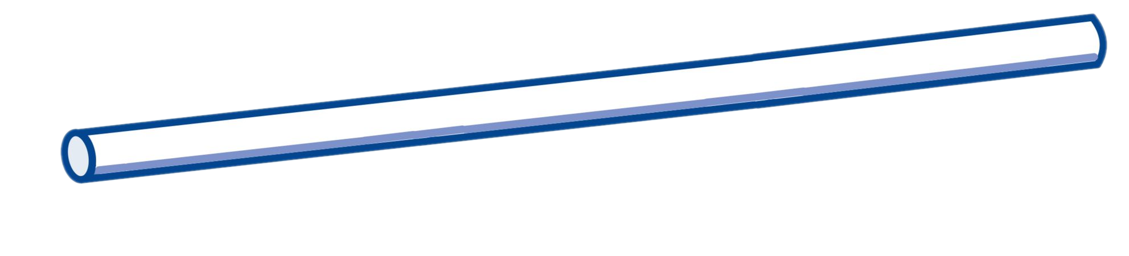
Assumptions:
1) The wave function obeys the wave equation
2) one infinitesimally small piece of the rod accelerates at the same rate as the piece of rod next to it.

Slide 184
Assumptions:
1) The wave function obeys the wave equation
2) one infinitesimally small piece of the rod accelerates at the same rate as the piece of rod next to it.

Slide 185
Assumptions:
1) The wave function obeys the wave equation
2) one infinitesimally small piece of the rod accelerates at the same rate as the piece of rod next to it.

Slide 186
Assumptions:
1) The wave function obeys the wave equation
2) one infinitesimally small piece of the rod accelerates at the same rate as the piece of rod next to it.

Slide 187
Assumptions:
1) The wave function obeys the wave equation
2) one infinitesimally small piece of the rod accelerates at the same rate as the piece of rod next to it.

Slide 188
Assumptions:
1) The wave function obeys the wave equation
2) one infinitesimally small piece of the rod accelerates at the same rate as the piece of rod next to it.

Slide 189
Assumptions:
1) The wave function obeys the wave equation
2) one infinitesimally small piece of the rod accelerates at the same rate as the piece of rod next to it.

Slide 190
Assumptions:
1) The wave function obeys the wave equation
2) one infinitesimally small piece of the rod accelerates at the same rate as the piece of rod next to it.

Slide 191
Assumptions:
1) The wave function obeys the wave equation
2) one infinitesimally small piece of the rod accelerates at the same rate as the piece of rod next to it.

Slide 192
Assumptions:
1) The wave function obeys the wave equation
2) one infinitesimally small piece of the rod accelerates at the same rate as the piece of rod next to it.

Slide 193
Assumptions:
1) The wave function obeys the wave equation
2) one infinitesimally small piece of the rod accelerates at the same rate as the piece of rod next to it.

Slide 194
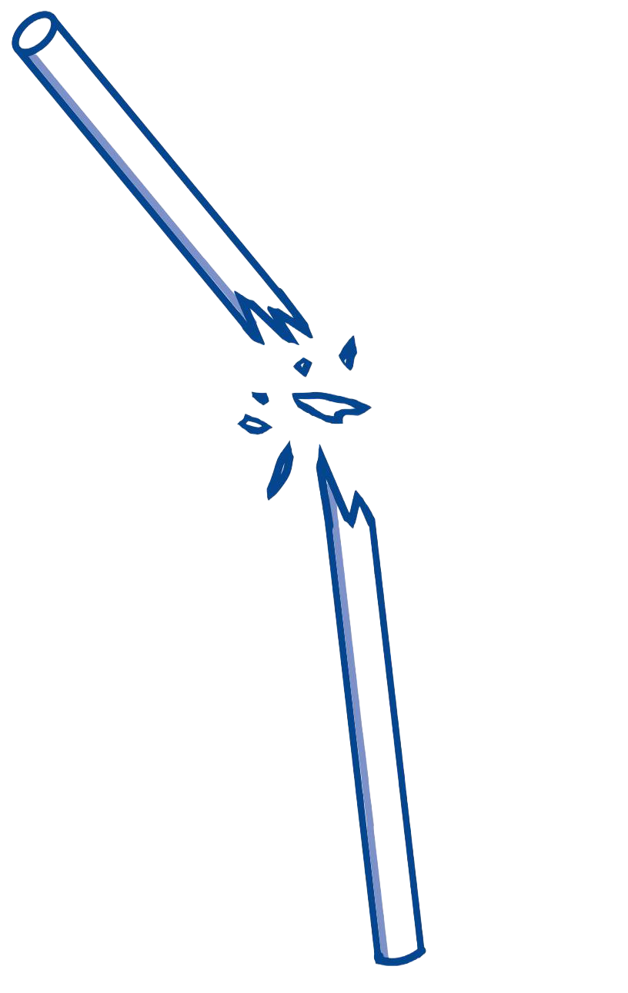
Assumptions:
1) The wave function obeys the wave equation
2) one infinitesimally small piece of the rod accelerates at the same rate as the piece of rod next to it.

Slide 195
Assumptions:
1) The wave function obeys the wave equation
2) one infinitesimally small piece of the rod accelerates at the same rate as the piece of rod next to it.

Slide 196
Assumptions:
1) The wave function obeys the wave equation
2) one infinitesimally small piece of the rod accelerates at the same rate as the piece of rod next to it.

Slide 197
Assumptions:
1) The wave function obeys the wave equation
2) one infinitesimally small piece of the rod accelerates at the same rate as the piece of rod next to it.

Slide 198
Assumptions:
1) The wave function obeys the wave equation
2) one infinitesimally small piece of the rod accelerates at the same rate as the piece of rod next to it.

Slide 199
Assumptions:
1) The wave function obeys the wave equation
2) one infinitesimally small piece of the rod accelerates at the same rate as the piece of rod next to it.

Slide 200
Assumptions:
1) The wave function obeys the wave equation
2) one infinitesimally small piece of the rod accelerates at the same rate as the piece of rod next to it.

Slide 201
Assumptions:
1) The wave function obeys the wave equation
2) one infinitesimally small piece of the rod accelerates at the same rate as the piece of rod next to it.

Slide 202
Assumptions:
1) The wave function obeys the wave equation
2) one infinitesimally small piece of the rod accelerates at the same rate as the piece of rod next to it.

Slide 203
Assumptions:
1) The wave function obeys the wave equation
2) one infinitesimally small piece of the rod accelerates at the same rate as the piece of rod next to it.

Slide 204
Assumptions:
1) The wave function obeys the wave equation
2) one infinitesimally small piece of the rod accelerates at the same rate as the piece of rod next to it.

Slide 205
Assumptions:
1) The wave function obeys the wave equation
2) one infinitesimally small piece of the rod accelerates at the same rate as the piece of rod next to it.

Slide 206
Assumptions:
1) The wave function obeys the wave equation
2) one infinitesimally small piece of the rod accelerates at the same rate as the piece of rod next to it.

Slide 207
Assumptions:
1) The wave function obeys the wave equation
2) one infinitesimally small piece of the rod accelerates at the same rate as the piece of rod next to it.

Slide 208
Assumptions:
1) The wave function obeys the wave equation
2) one infinitesimally small piece of the rod accelerates at the same rate as the piece of rod next to it.

Slide 209
Assumptions:
1) The wave function obeys the wave equation
2) one infinitesimally small piece of the rod accelerates at the same rate as the piece of rod next to it.

Slide 210
Assumptions:
1) The wave function obeys the wave equation
2) one infinitesimally small piece of the rod accelerates at the same rate as the piece of rod next to it.

Slide 211
Assumptions:
1) The wave function obeys the wave equation
2) one infinitesimally small piece of the rod accelerates at the same rate as the piece of rod next to it.

Slide 212
Assumptions:
1) The wave function obeys the wave equation
2) one infinitesimally small piece of the rod accelerates at the same rate as the piece of rod next to it.

Slide 213
Assumptions:
1) The wave function obeys the wave equation
2) one infinitesimally small piece of the rod accelerates at the same rate as the piece of rod next to it.

Slide 214
Assumptions:
1) The wave function obeys the wave equation
2) one infinitesimally small piece of the rod accelerates at the same rate as the piece of rod next to it.

Slide 215
Assumptions:
1) The wave function obeys the wave equation
2) one infinitesimally small piece of the rod accelerates at the same rate as the piece of rod next to it.

Slide 216
Assumptions:
1) The wave function obeys the wave equation
2) one infinitesimally small piece of the rod accelerates at the same rate as the piece of rod next to it.

